Slide 1




MicroProfile 6.1

Slide 2
What is MicroProfile?
MicroProfile is an open-source community specification for Enterprise Java microservices
A community of individuals, organizations, and vendors collaborating within an open source Eclipse Foundation Working Group to bring microservices to the Enterprise Java community

Slide 3
MicroProfile Working Group
In October 1st, 2020, MicroProfile became a member of the Eclipse Working Group to close its intellectual property gap
The MicroProfile Charter defines the MicroProfile Working Group vision and scope, governance, membership, and more.
MicroProfile component specifications follow the MicroProfile Specification Process, a compatible specialization of the Eclipse Specification Process.
MicroProfile 4.1 is the first release delivered under the MicroProfile Working Group with compatible implementation declared

Slide 4
Release Compatible Implementation
Defined the compatible implementation for MicroProfile 6.1
[Required] Passing the 8 MicroProfile Specification TCKs and Jakarta EE 10 Core Profile TCKs
MicroProfile Config 3.1
MicroProfile Fault Tolerance 4.0
MicroProfile Health 4.0
MicroProfile JWT Authentication 2.1
MicroProfile Metrics 5.1
MicroProfile OpenAPI 3.0
MicroProfile Telemetry 1.1
MicroProfile Rest Client 3.0
Jakarta EE 10 Core Profile
Use Java SE 11 or higher

Slide 5












Working Group Corporate Members

Slide 6








Current MicroProfile Implementations

Slide 7
MicroProfile 6.0 Released!
Released October 12th, 2022
Offered in the release:
Updated 3 MicroProfile Component specifications (Telemetry, Metrics, and Config)

Slide 8
MicroProfile Releases in 2023
Standalone
Telemetry 1.1
Open API 3.1
Rest Client 3.0
Config 3.1
Open Tracing 3.0
LRA 2.0
Fault Tolerance 4.0
Metrics 5.1
JWT Authentication 2.1
Health 4.0
Reactive Messaging 3.0
GraphQL 2.0
Jakarta EE 10 Core Profile
Reactive Streams Operators 3.0
Context Propagation 1.3
MicroProfile 6.1
Outside umbrella
= New
= Updated
= No change from last release

Slide 9
MicroProfile Config 3.1
Provides an easy to use and flexible system for application configuration
What's new
A few TCK were updated to allow it running with either Jakarta EE 10 Core Profile or Jakarta EE 9.1
Minor spec clarification

Slide 10
MicroProfile Fault Tolerance 4.0
Defines easy to use and flexible APIs for building resilient applications

Slide 11
MicroProfile Health 4.0
Expose the availability of a MicroProfile runtime to underlying platform

Slide 12
MicroProfile JWT Authentication 2.1
Using OpenID Connect(OIDC) based JSON Web Tokens(JWT) for role based access control(RBAC) of microservice endpoints.

Slide 13
MicroProfile Metrics 5.1
Define custom application metrics and expose platform metrics on a standard endpoint using standard formats
What's new
Functional Changes
Introduced MP Config properties that customize how Histogram and Timer metrics track and output statistics for percentiles and histogram-buckets. (691)(676)(675)(674)(587)
@RegistryScope is now a qualifier (749)
Other changes
Include new recommendation for multi-application deployments to use a mp.metrics.defaultAppName property (766)

Slide 14
MicroProfile Telemetry 1.1
Trace request flows between service boundaries
What's new
Consume the OpenTelemetry Java release v1.29.0. The full comparison with the v1.19.0 supported by MicroProfile Telemetry 1.0 can be found here.
Other Changes
Consume the latest OpenTelemetry Tracing (88)
Clarify which API classes must be available to users (91)
Clarify the behaviour of Span and Baggage beans when the current span or baggage changes (90)
TCK: Implement tests in a way that is not timestamp dependent (44)
TCK: TCK RestClientSpanTest Span Name Doesn’t Follow Semantic Conv (86)
TCK: Adding missing TCKs (89)
TCK: TCK cannot be run using the Arquillian REST protocol (72)

Slide 15
MicroProfile OpenAPI 3.1
Provides Java interfaces and programming models to natively produce OpenAPI v3 documents from JAX-RS applications

Slide 16
MicroProfile Rest Client 3.0
Type-safe rest client defined as Java interfaces

Slide 17
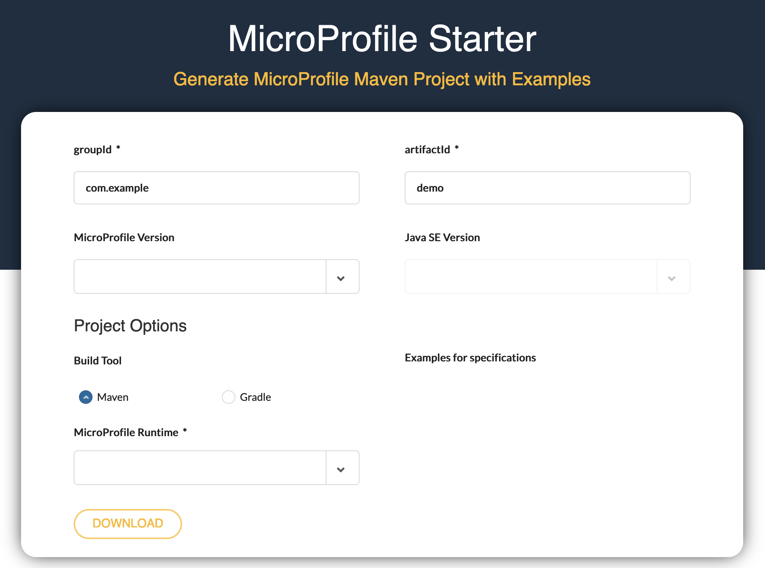
start.microprofile.io
Generate MicroProfile projects
Visual Studio Code plugin
IntelliJ Plugin
Command line tooling

Slide 18
MicroProfile Reactive Capabilities
MicroProfile Reactive Streams Operators
A set of operators to create new reactive streams, process the transiting data and consume them with ease
MicroProfile Reactive Messaging
Defines a development model for declaring CDI beans producing, consuming and processing messages. It relies on Reactive Streams Operators and CDI
MicroProfile Context Propagation
APIs for propagating contexts across units of work that are thread-agnostic
Reactive Streams Operators 3.0
- Project page - Spec PDF doc - Spec HTML doc - Technology Compatibility Kit (TCK)
MicroProfile Reactive Messaging 3.0
- Project page - Spec PDF doc - Spec HTML doc - Technology Compatibility Kit (TCK)
Context Propagation 1.3
- Project page - Spec PDF doc - Spec HTML doc - Technology Compatibility Kit (TCK)
Standalone Specifications

Slide 19

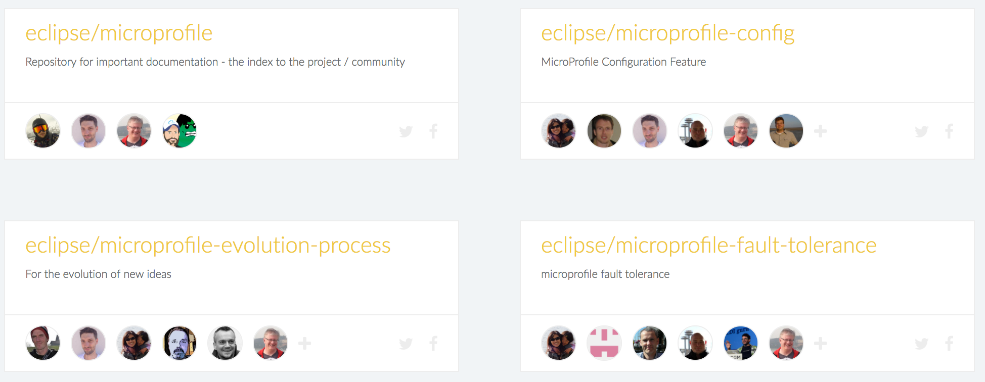


Get Involved!
Google Groups
MicroProfile Projects
Bi-Weekly & Quarterly
General community
Meetings
YouTube Channel

Slide 20
MicroProfile
Copyright © 2023, Eclipse Foundation, Inc. | Made available under the Eclipse Public License 2.0 (EPL-2.0)

